Slide 1

"Smart Table Service: Streamlining Food Delivery and Payment for an Enhanced Dining Experience"
Notes:
Line spacing + Page numbers

Slide 2

Under the guidance of Prof. Sayali Sanmukh

Slide 3

Contributed By:
Sankalp Gunare B-70
Abhishek Sutar B-66
Harikrishna Bomen B-67
Shridhar Kandikatla B-69
Sumit Doke B-68

Slide 4
Abstract
A smart restaurant using QR code technology is a system that leverages the ubiquitousness of smartphones and the convenience of QR codes to provide an efficient and hassle-free dining experience for customers. The system consists of a back-end database, a web application for restaurant owners, and a mobile application for customers. The mobile application enables customers to scan QR codes displayed on tables to access the restaurant's digital menu. Customers can browse the menu, select their desired items, and add them to their order. The system also enables customers to make payments using mobile wallets, credit or debit cards, and provide feedback about their dining experience. On the other hand, the web application is designed for restaurant owners to manage their menu, track orders, and payments, monitor customer feedback, and generate reports. Restaurant owners can also access the system analytics to gain insights into the customers' preferences, peak hours, and order trends, which can help in optimizing the restaurant's operations. The different diagrams presented in this paper, including use case, sequence, data flow, and class diagrams, provide a detailed view of the system architecture and its different components. The use case diagram describes the different interactions between the actors and the system, while the sequence diagram shows the sequence of events when a customer places an order. The data flow diagram illustrates how data flows through the different components of the system, while the class diagram provides a detailed view of the system's different classes and their relationships. Overall, the implementation of a smart restaurant using QR code technology can provide several benefits, including enhanced customer experience, improved restaurant operations, and increased customer loyalty. This paper provides a comprehensive overview of the system requirements, design, and implementation of a smart restaurant using QR code technology, which can serve as a valuable reference for anyone interested in implementing this system.

Slide 5
Agenda
01 Customer Side
02 Hotel Staff Side
03 Tools/Software
04 Hardware
05 Advantages

Slide 6
introduction
Introduction: The hospitality industry has undergone significant changes in recent years, with the rise of mobile technology and the increasing demand for contactless services. One of the most notable changes has been the adoption of QR code technology in restaurants. QR codes are a type of two-dimensional barcode that can be scanned using a smartphone camera, providing access to information or services. In the restaurant industry, QR codes are being used to enhance the customer experience and reduce contact between customers and staff. A smart restaurant that uses QR code technology allows customers to access menus, place orders, and make payments using their mobile devices. This paper explores the benefits of a smart restaurant using QR code technology, including the advantages of digital feedback systems and the potential for data analytics to provide insights into customer behavior and preferences. The results of this study demonstrate that a smart restaurant using QR code technology can enhance the customer experience, improve operational efficiency, and increase revenue in the hospitality industry.

Slide 7
Project Objectives
Our project objectives are,
● To reduce physical contact between customers and staff.
● To improve the speed and efficiency
● To personalize the dining experience
● To enhance the accuracy of orders
● To increase customer satisfaction and loyalty
● To reduce the environmental impact
● To collect customer feedback
● To analyze customer behavior and preferences

Slide 8
Project info
This project idea is dedicated to improving scenarios in restaurants and hotels for better customer experience. The concept is simple to implement and very useful for every kind of food place whether it is a small restaurant or a big hotel. The system provides managed food delivery right to the table (without any confusion) and smart payment options for saving time.

Slide 9
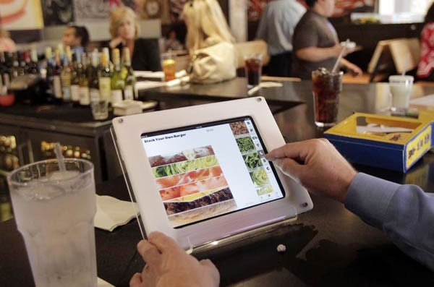
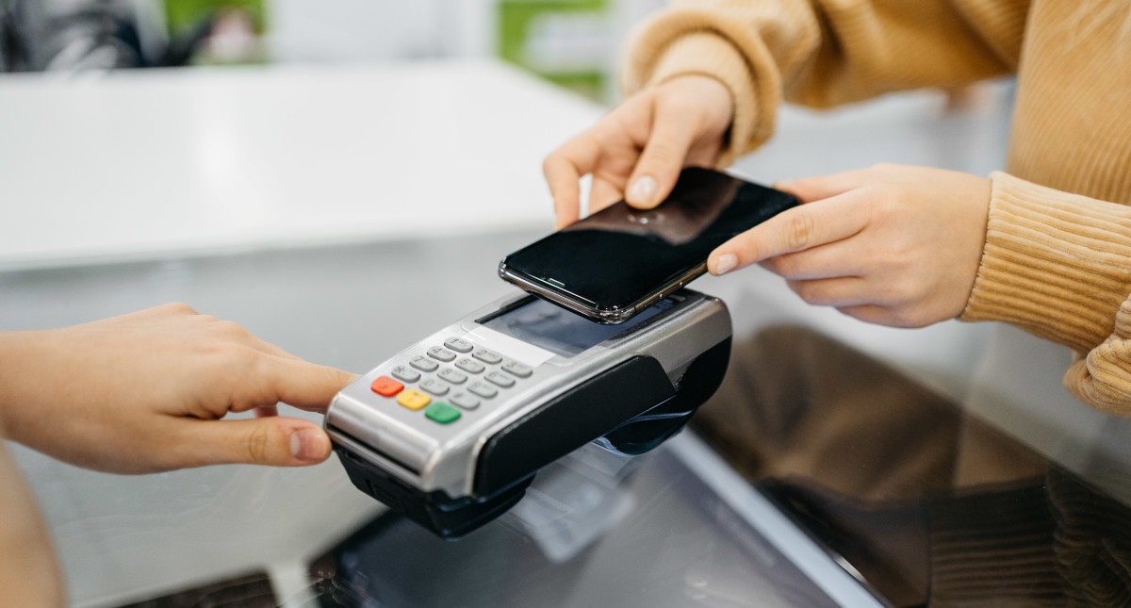
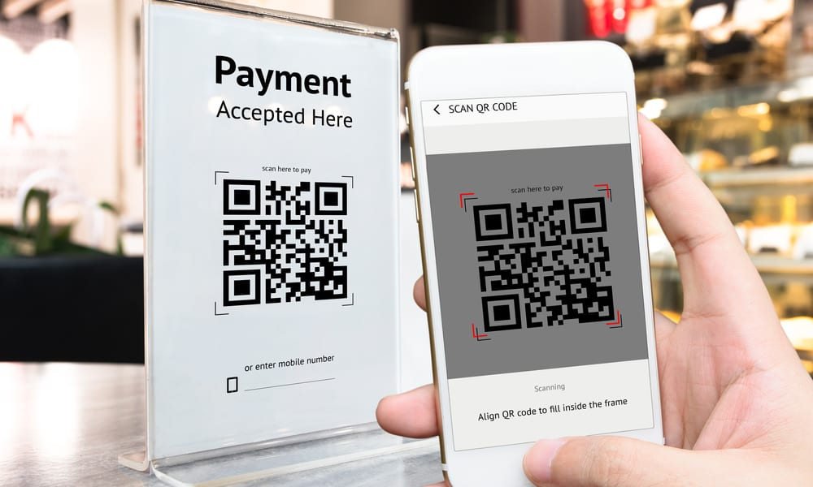
Customer Side
01
Touch Screen Device on Table.
Menu
Smart Payment
Cardless, QR, Debit transaction
Feedback

Slide 10
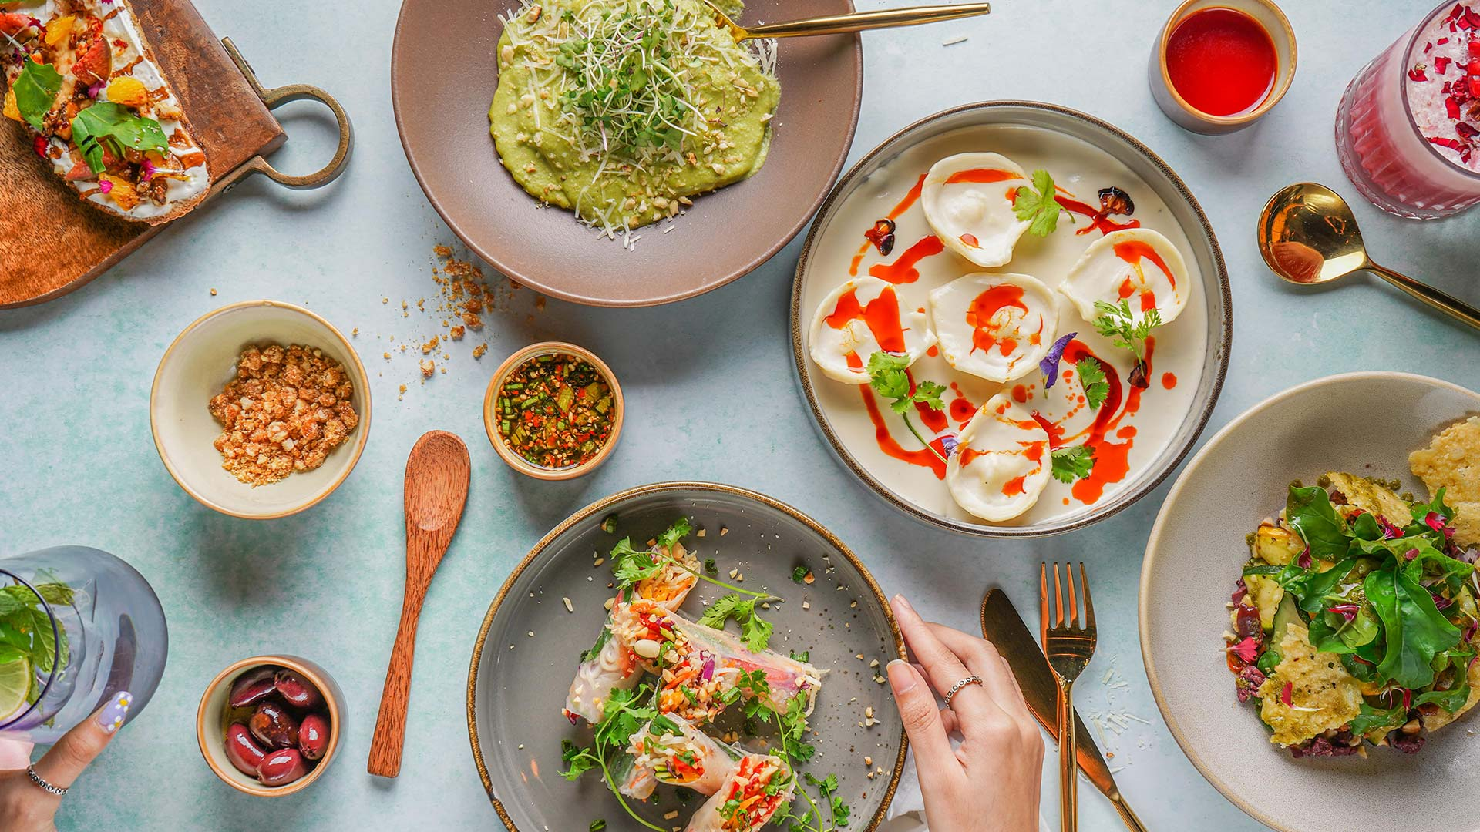
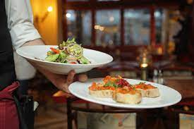
Hotel Staff Side
02
Desktop
Staff food management
Better user experience

Slide 11
Features
Customer Side Features in Restaurant Management System:
Menu display with clear descriptions and pictures of each dish
Online ordering with customization options
Reservation system for table booking
Multiple payment options including credit/debit cards, cash, and digital wallets
Feedback system for leaving reviews and ratings
Staff Side Features in Restaurant Management System:
Order management for viewing and managing all orders
Table management for assigning tables, managing waitlists, and tracking availability
Inventory management for tracking stock levels and setting up automated alerts
Employee management for tracking schedules, payroll, and performance
Reporting and analytics for generating reports on sales, revenue, and customer feedback.

Slide 12

Tools/Software
03
Java
HTML
CSS
JAVASCRIPT
PHP
MYSQL

Slide 13
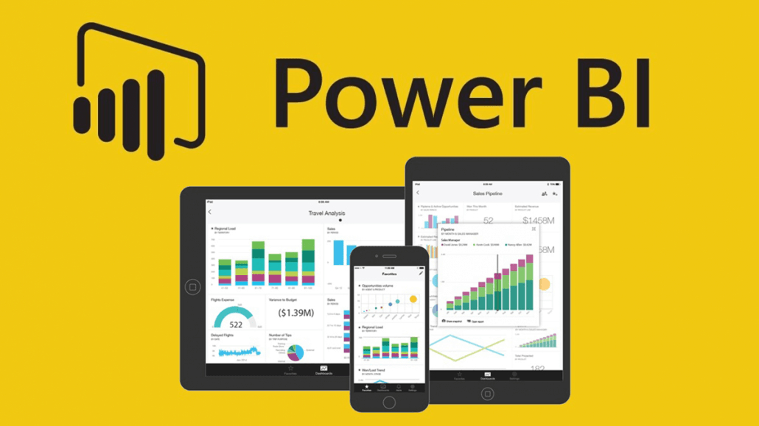
Platform for Technology
Front-end development.
Back-end development
Node.js. Web application frameworks
Applications Requirements
Power BI

Slide 14
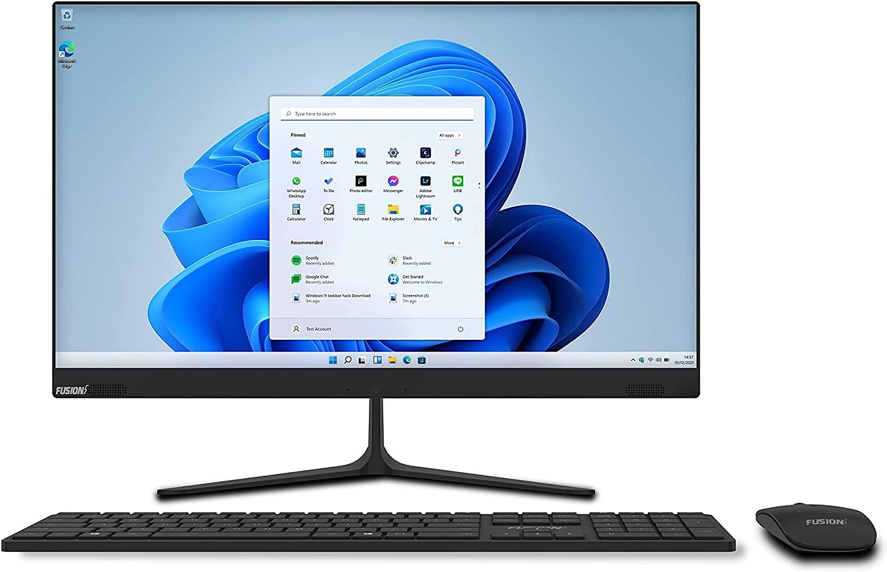
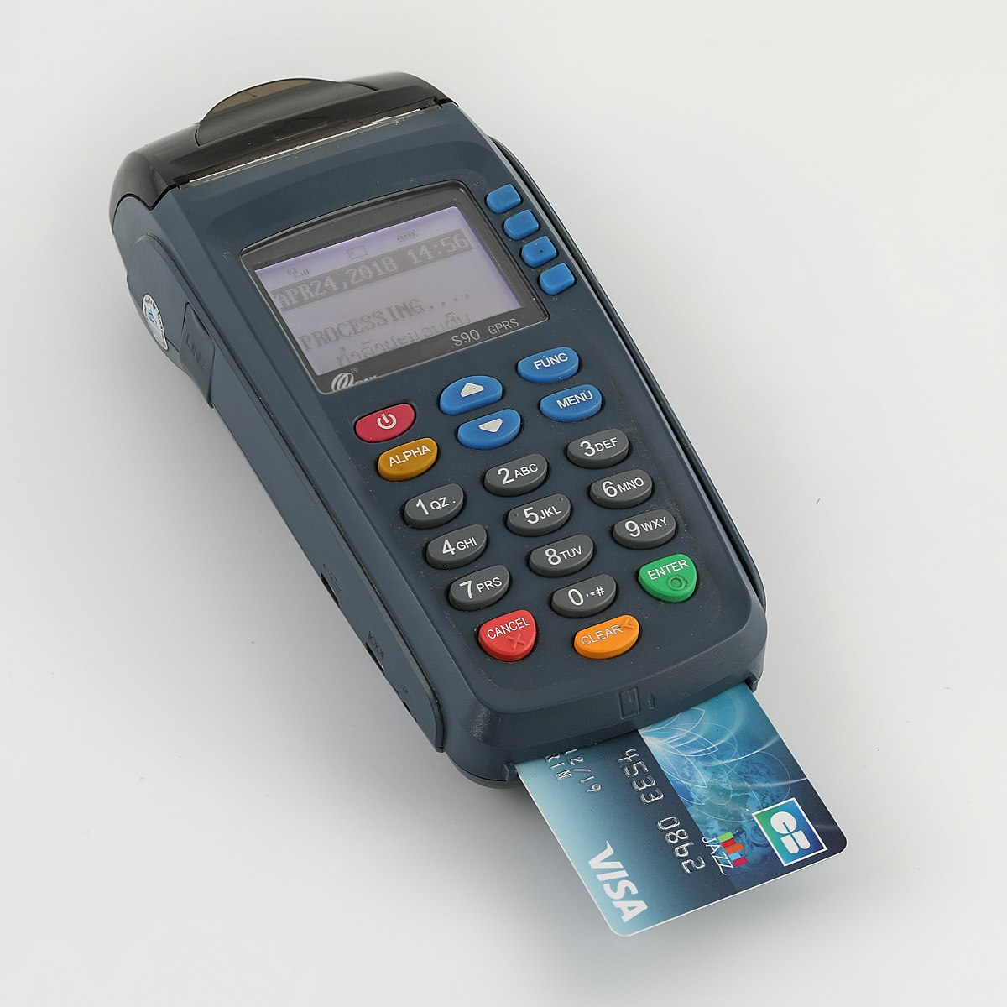
Hardware
04
Hardware:
Touch-screen device, Card swipe device and any general purpose desktop.

Slide 15
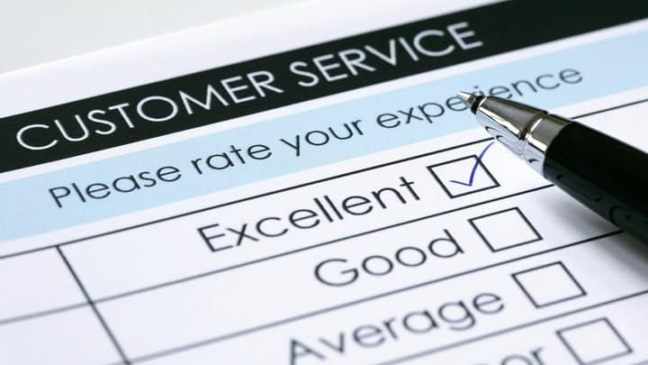

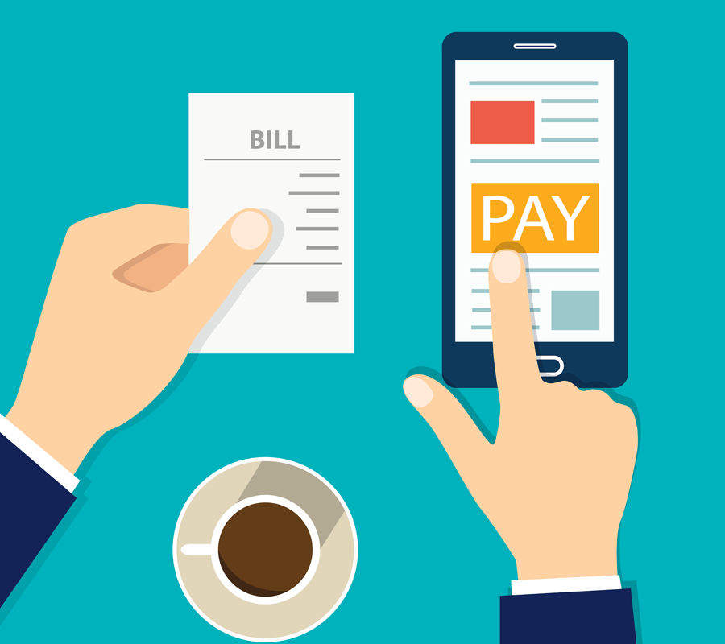
05
Advantages
Better customer/user experience
Time saver
No confusions
Easy payments

Slide 16
Scope
The project scope for a smart restaurant using QR code technology includes the development of a custom QR code system that allows customers to access menus, place orders, and make payments using their mobile devices. The QR code system will be integrated with the restaurant's existing POS system to enable efficient order processing and payment. Additionally, a digital feedback system will be implemented to allow customers to leave feedback on their dining experience using their mobile devices. Data collected from the QR code system and digital feedback system will be analyzed to gain insights into customer behavior and preferences. Based on this data analysis, targeted marketing campaigns and promotions will be developed to better meet the needs of the customers. To ensure smooth and efficient operations, staff will be trained on the use of the QR code system and digital feedback system. The QR code system will be regularly maintained and updated to ensure compatibility with new mobile devices and operating systems. The QR code system will also be integrated with the restaurant's loyalty program, allowing customers to earn rewards for their purchases. A privacy and security policy will be implemented to address customer concerns about the use of QR code technology. Finally, the QR code system and digital feedback system will be regularly evaluated to ensure they are meeting the needs of the customers and the restaurant.

Slide 17
Area of Use
Ordering and payment
Inventory management
Kitchen management
Customer service
Marketing and loyalty programs
Analytics and reporting

Slide 18
Example (Real use- video)
Link: https://youtu.be/lGAJCEpDl7A

Slide 19
References
www.w3school.com
https://nodejs.org/en/docs/
https://www.mongodb.com/home
https://developer.mozilla.org/en-US/
Chung, J., & Lee, S. (2019). Smart restaurant service system using QR code. International Journal of Advanced Science and Technology, 28(17), 551-558. 6. Kim, M. H., Jeong, Y. J., & Chung, N. (2018). A study on the factors influencing customer satisfaction in restaurant QR code payment service. Journal of Digital Convergence, 16(11), 217-228. 7. Sun, S., & Ma, L. (2017). A survey of security and privacy issues for QR code-based mobile payment systems. Journal of Network and Computer Applications, 83, 13-28. 8. Tse, W. H., & Chu, K. W. (2018). A study of customer acceptance of QR code payment in a Japanese restaurant. Journal of Retailing and Consumer Services, 41, 242-248. 9. Yoon, J. W., Kim, C. H., & Jung, J. H. (2019). The effect of QR code menu on customer experience. Journal of Distribution Science, 17(8), 43-51.

Slide 20
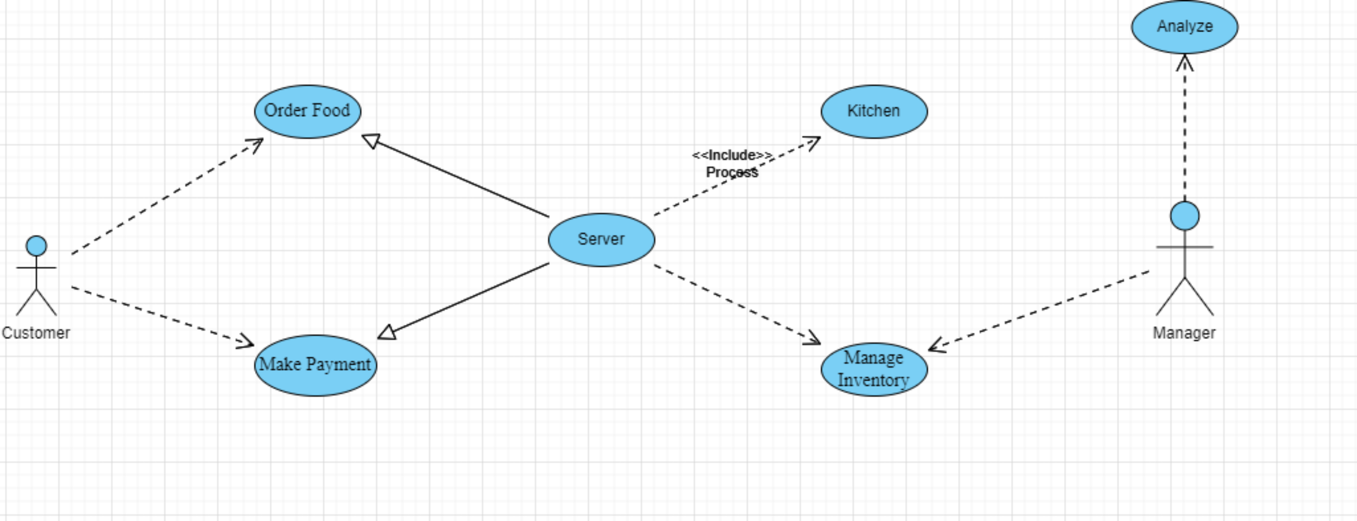
Usecase Diagram

Slide 21
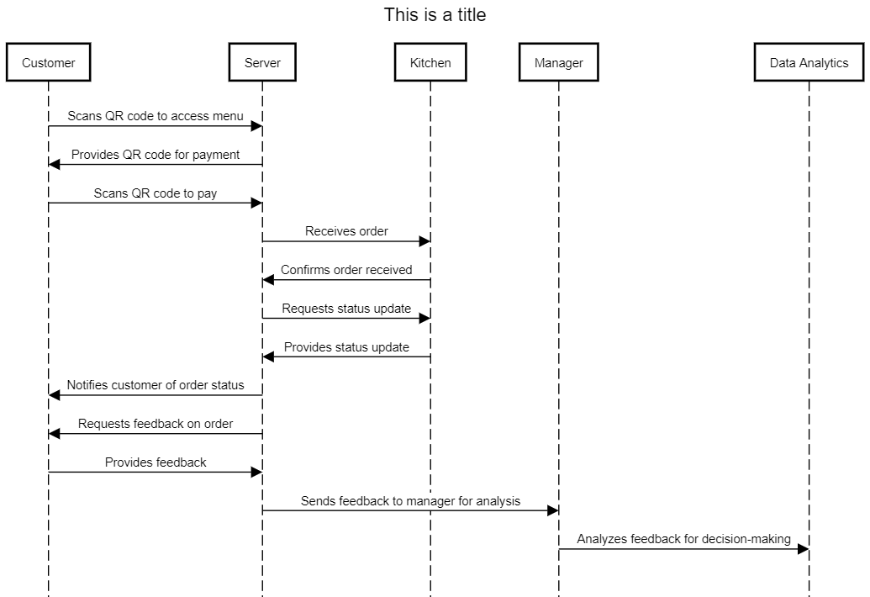
Smart Restaurent Sequence Diagram

Slide 22
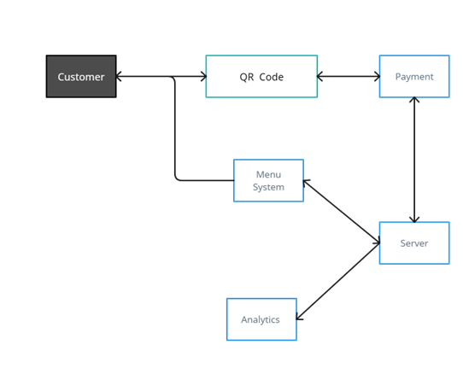
Untitled Workspace

Slide 23

Work of team members
Team Leader and Governing and Relation Officer : Sankalp Gunare
Frontend : Abhishek Sutar
Backend and Database : Shridhar and Harikrishna
Managing and Operations Manager : Sumit Doke

Slide 24
Thanks to Mentor 🙏🏻
As someone who has received guidance and support from a mentor during a project, I know how important it is to acknowledge their contributions and show appreciation. My mentor played a vital role in providing valuable feedback, expertise, and support that helped me develop my skills and achieve my goals. I want to express my gratitude towards my mentor for their tireless efforts and invaluable insights that helped make the project a success. Whether it's a simple thank you message or a thoughtful gift, expressing gratitude towards a mentor can help to strengthen the relationship and foster a culture of collaboration and support.

